Slide 1

Sadık Can Güler Mehmet Yusuf Ocak
Inventory Manegement System

Slide 2

Contents
Introduction For Project
UML Diagram
Data Structures
Object-Oriented Programming (OOP) Concepts
Project Features

Slide 3

INTRODUCTION
What is the main idea of Inventory Management System Project?

Slide 4
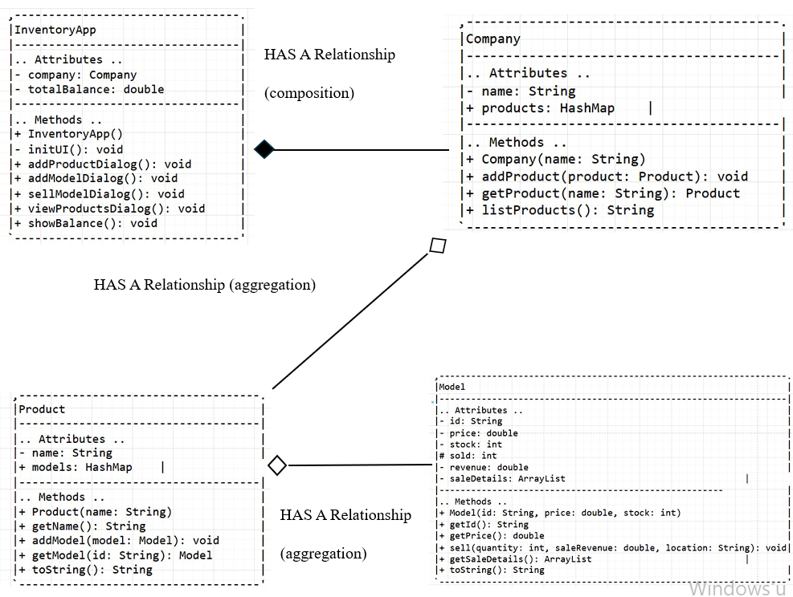
UML DIAGRAM

Slide 5

Data Structures
HashMap
ArrayList

Slide 6
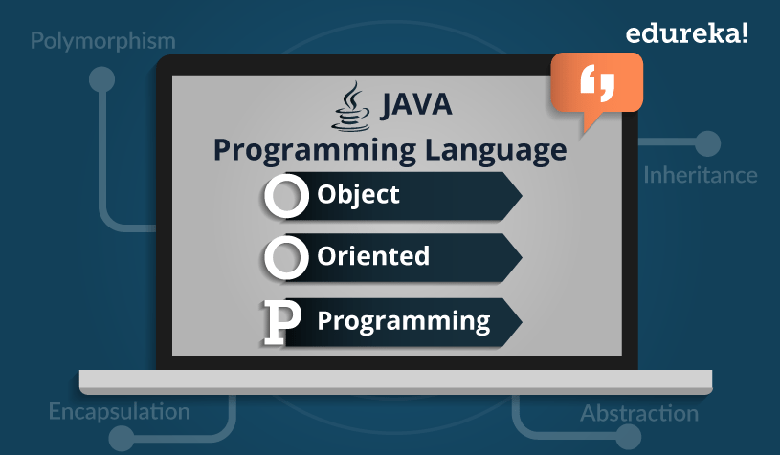
Object-Oriented Programming (OOP) Concepts
Encapsulation
Polymorphism
Abstraction
Inheritance

Slide 7
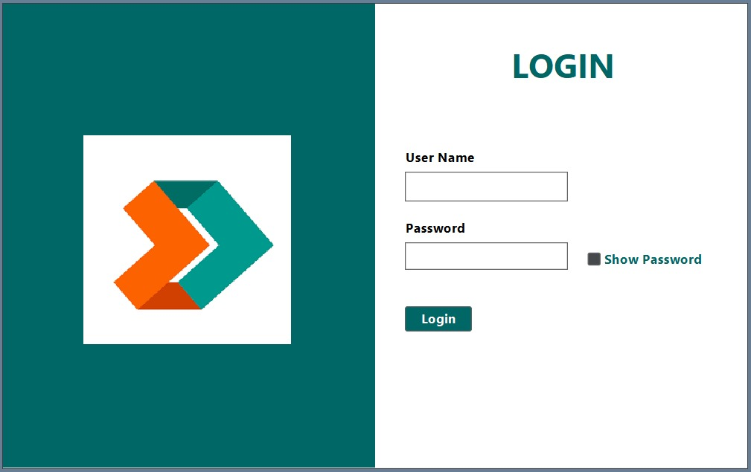
Project Features
ADMINISTRATOR DASHBOARD

Slide 8
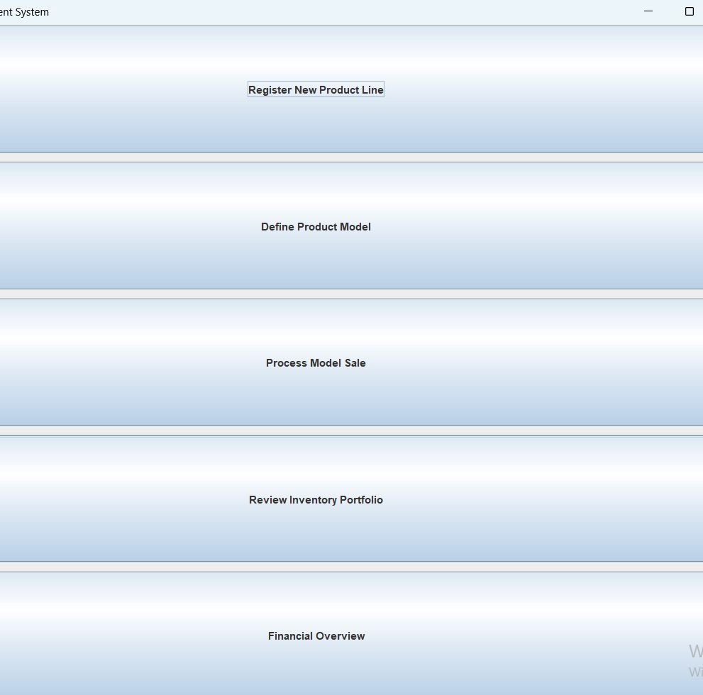
INVENTORY MANAGEMENT SYSTEM SCREEN

Slide 9
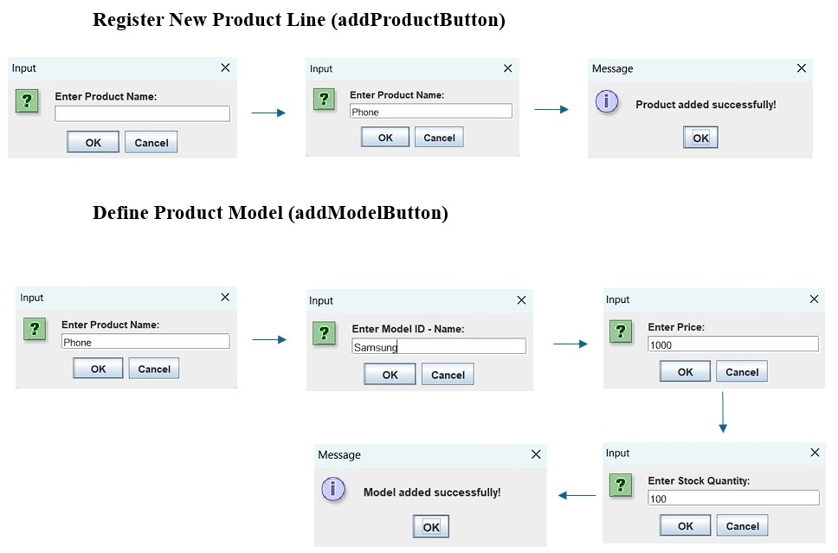

Slide 10
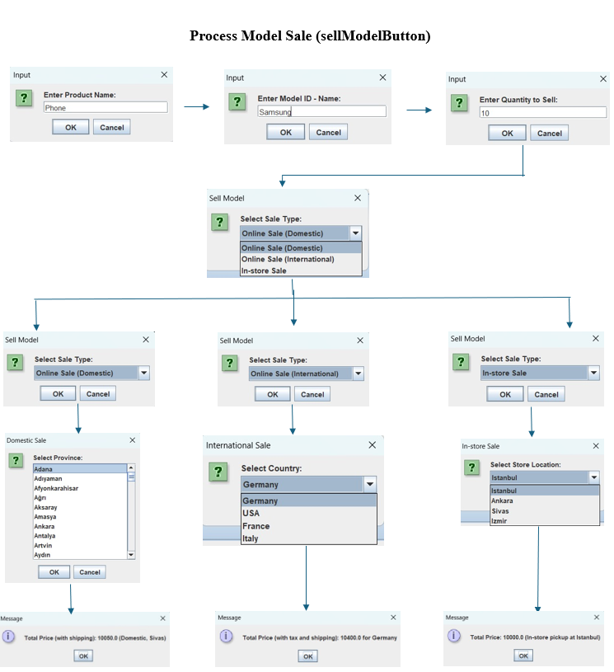
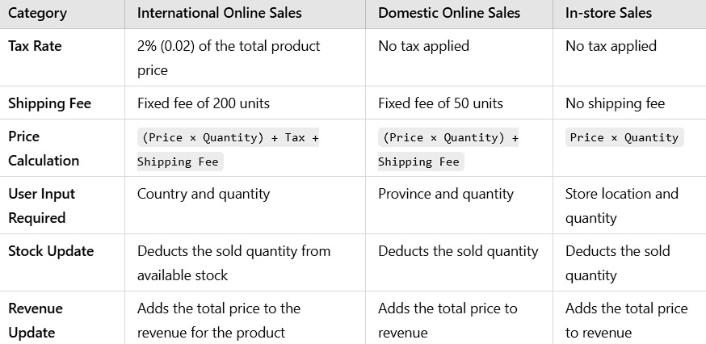

Slide 11
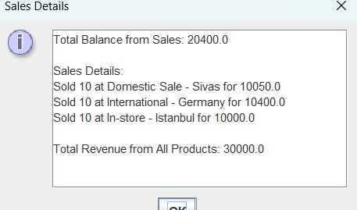
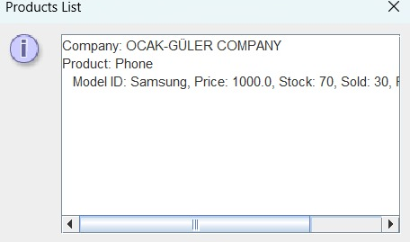
View Inventory Portfolio(viewProductsButton)
Financial Overview(balanceButton)

Slide 12

Thanks For Listening ☺

